Slide 1

Physics-constrained Deep Learning for Modeling and Control of Buildings
Invited talk: Sidewalk Labs, 17th of June 2021
Jan Drgona
Collaborators: Elliott Skomski, Soumya Vasisht,
Aaron Tuor, Vikas Chandan, Draguna Vrabie

Slide 2
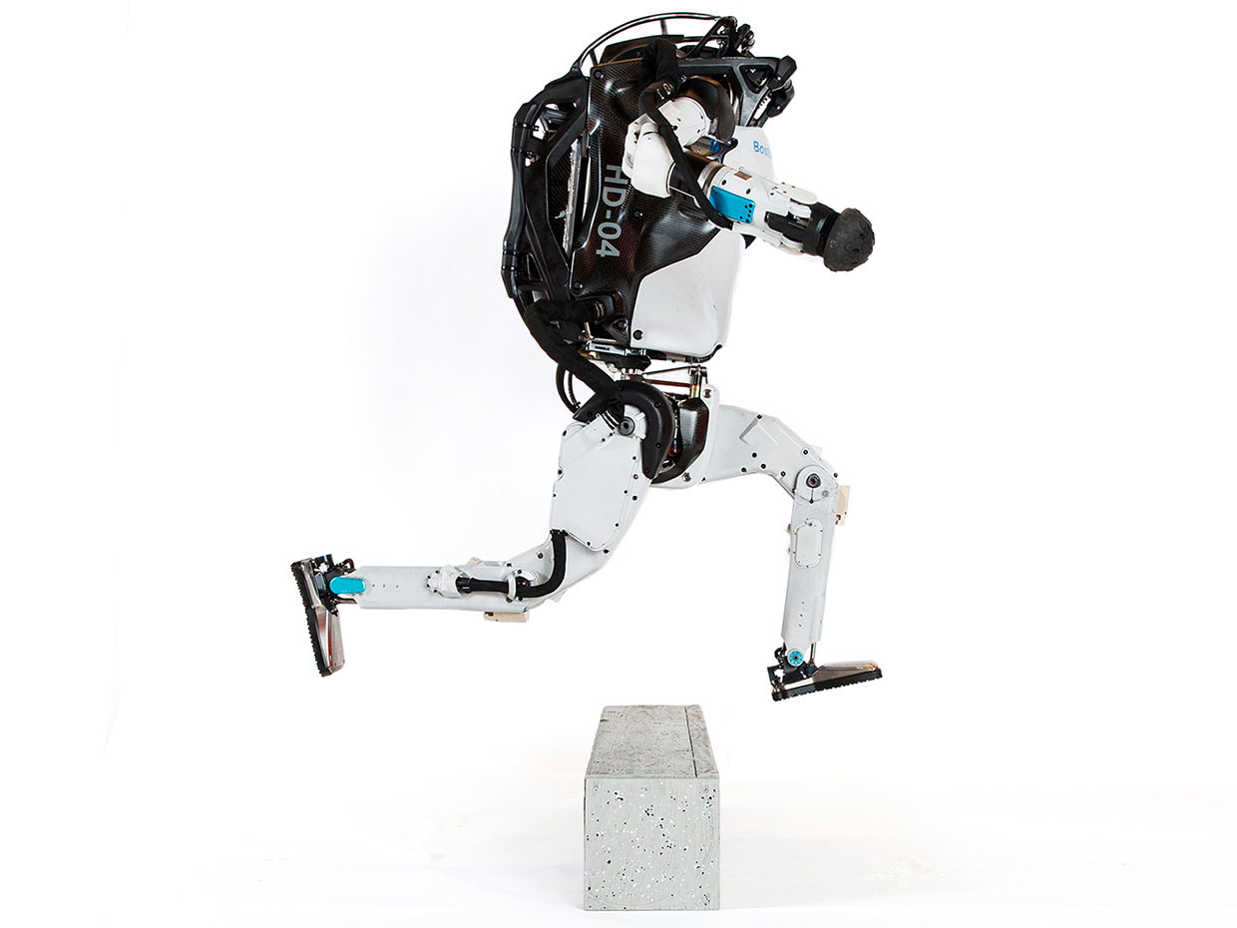


Model Predictive Control
Successes
Challenges
95% of the process control applications are PID loops using trial and error rule-based optimization. The rest is model predictive control (MPC).
Modeling
Unknown or partially known dynamics
Physics-based modeling is expensive
Purely data-driven models lack generalization
Real-time optimization
Scalability
Computational limitations of control hardware
Parallelization, distributed optimization
Assumption:
Reliable and accurate system dynamics model
Drgona J., J. Arroyo, I.C. Figueroa, D. Blum, K. Arendt, D. Kim, and E.P. Olle, J. Oravec, M. Wetter, D. L. Vrabie, L. Helsen. 2020. "All You Need to Know About Model Predictive Control for Buildings." Annual Reviews in Control, September 29, 2020
Notes:
Domain awareness, trusted autonomy
PID controller-
A PID controller continuously calculates an error value
the difference between a desired setpoint (SP) a process variable (PV) and
Correction based on proportion of error, integration of accumulated error, and derivative of the error
MPC first developed in the chemical industry to address some of the shortcomings of a PID controller.
Designed to handle MIMO systems
Can handle constraints
Preview capability
MPC uses a model to predict future outcomes of a process.
Online optimization problem at each process interval. Performs first action in the rollout.
requiring large memory and fast processor to operate in real time.
Training and calibration of models- lots of expert time
Optimization: translation to a solver language- lots of expert time
Computational limitations of control hardware depending on the system

Slide 3
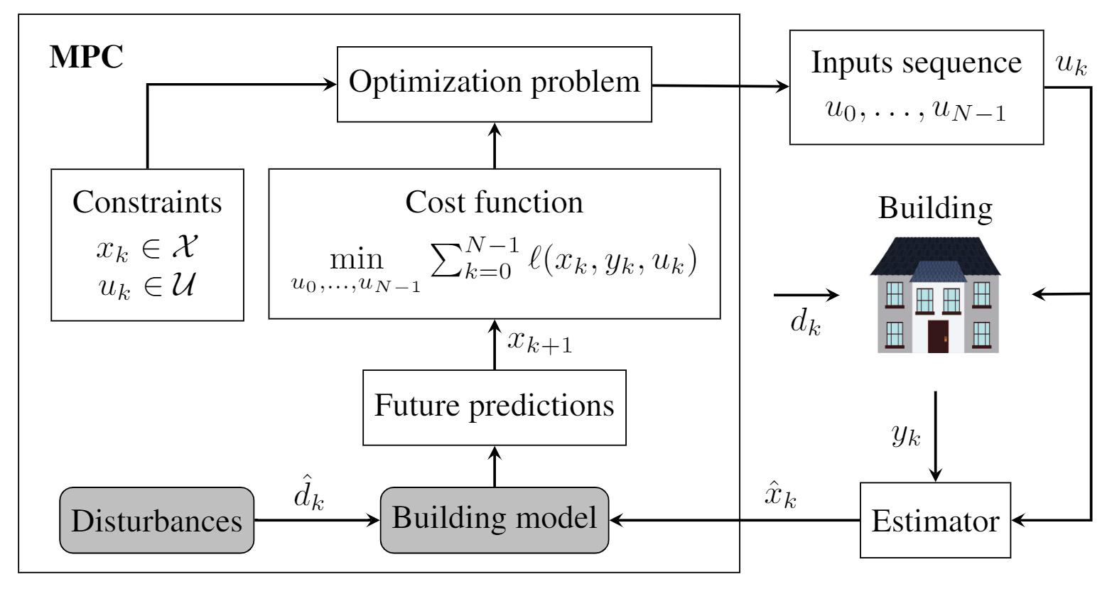
Model Predictive Control for Building HVAC Systems
Drgona J., J. Arroyo, I.C. Figueroa, D. Blum, K. Arendt, D. Kim, and E.P. Olle, J. Oravec, M. Wetter, D. L. Vrabie, L. Helsen. 2020. "All You Need to Know About Model Predictive Control for Buildings." Annual Reviews in Control, September 29, 2020
Notes:
Domain awareness, trusted autonomy
PID controller-
A PID controller continuously calculates an error value
the difference between a desired setpoint (SP) a process variable (PV) and
Correction based on proportion of error, integration of accumulated error, and derivative of the error
MPC first developed in the chemical industry to address some of the shortcomings of a PID controller.
Designed to handle MIMO systems
Can handle constraints
Preview capability
MPC uses a model to predict future outcomes of a process.
Online optimization problem at each process interval. Performs first action in the rollout.
requiring large memory and fast processor to operate in real time.
Training and calibration of models- lots of expert time
Optimization: translation to a solver language- lots of expert time
Computational limitations of control hardware depending on the system

Slide 4
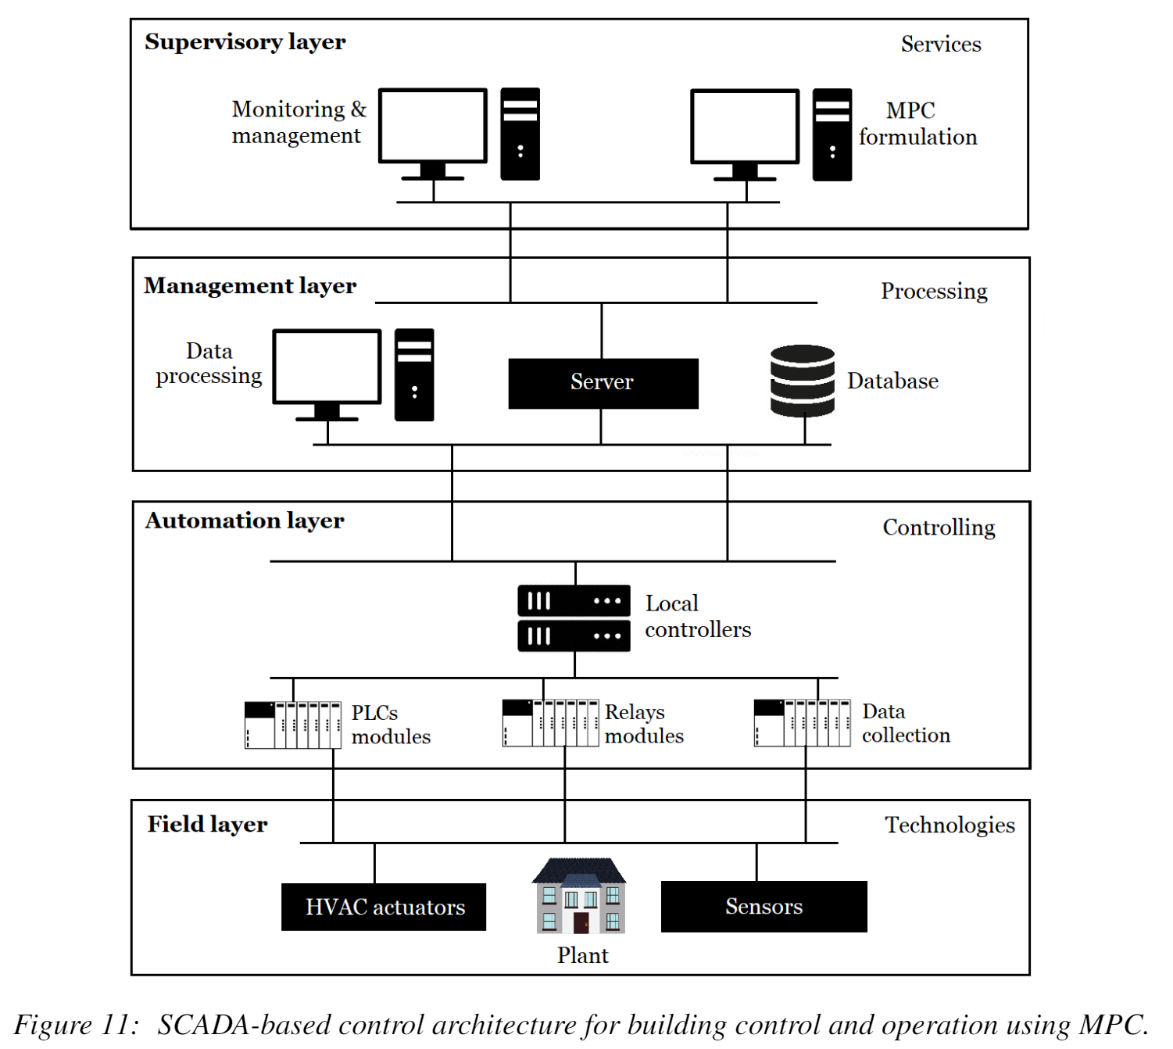
SCADA Systems in Buildings
Drgona J., J. Arroyo, I.C. Figueroa, D. Blum, K. Arendt, D. Kim, and E.P. Olle, J. Oravec, M. Wetter, D. L. Vrabie, L. Helsen. 2020. "All You Need to Know About Model Predictive Control for Buildings." Annual Reviews in Control, September 29, 2020
Notes:
Domain awareness, trusted autonomy
PID controller-
A PID controller continuously calculates an error value
the difference between a desired setpoint (SP) a process variable (PV) and
Correction based on proportion of error, integration of accumulated error, and derivative of the error
MPC first developed in the chemical industry to address some of the shortcomings of a PID controller.
Designed to handle MIMO systems
Can handle constraints
Preview capability
MPC uses a model to predict future outcomes of a process.
Online optimization problem at each process interval. Performs first action in the rollout.
requiring large memory and fast processor to operate in real time.
Training and calibration of models- lots of expert time
Optimization: translation to a solver language- lots of expert time
Computational limitations of control hardware depending on the system

Slide 5
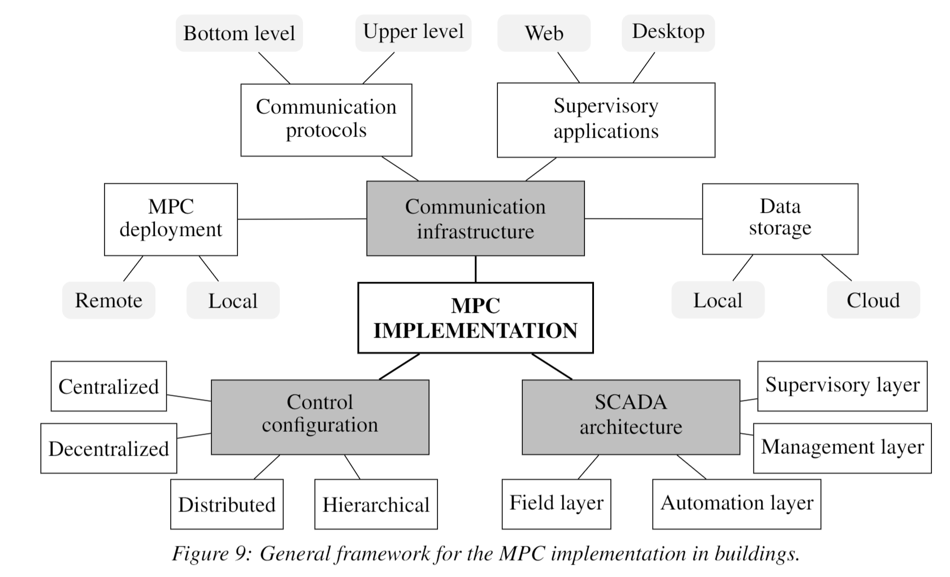
Implementation of MPC in Building Management Systems
Drgona J., J. Arroyo, I.C. Figueroa, D. Blum, K. Arendt, D. Kim, and E.P. Olle, J. Oravec, M. Wetter, D. L. Vrabie, L. Helsen. 2020. "All You Need to Know About Model Predictive Control for Buildings." Annual Reviews in Control, September 29, 2020
Notes:
Domain awareness, trusted autonomy
PID controller-
A PID controller continuously calculates an error value
the difference between a desired setpoint (SP) a process variable (PV) and
Correction based on proportion of error, integration of accumulated error, and derivative of the error
MPC first developed in the chemical industry to address some of the shortcomings of a PID controller.
Designed to handle MIMO systems
Can handle constraints
Preview capability
MPC uses a model to predict future outcomes of a process.
Online optimization problem at each process interval. Performs first action in the rollout.
requiring large memory and fast processor to operate in real time.
Training and calibration of models- lots of expert time
Optimization: translation to a solver language- lots of expert time
Computational limitations of control hardware depending on the system

Slide 6
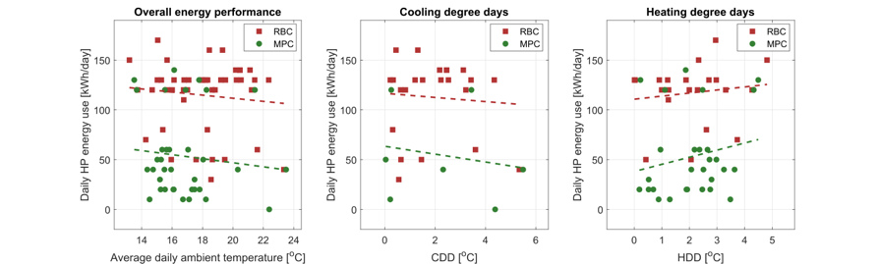
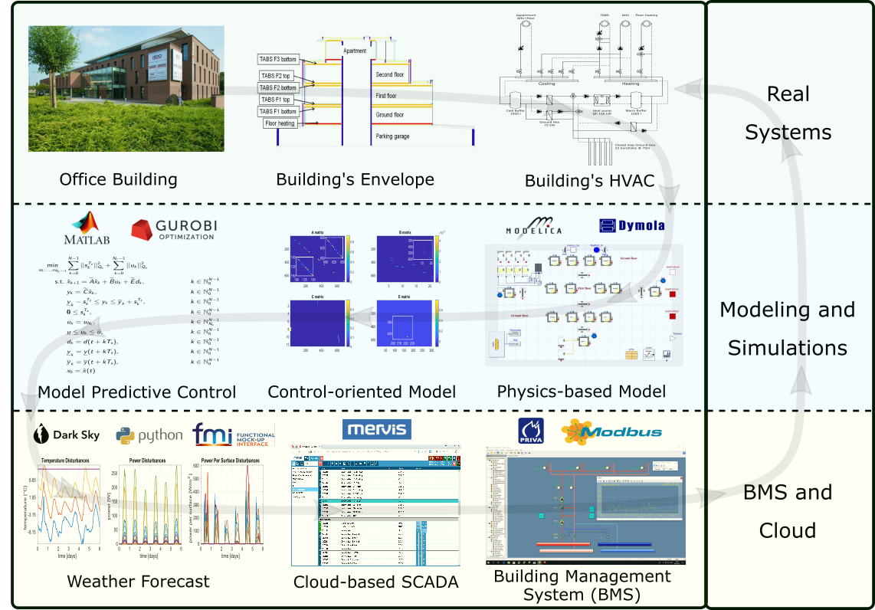
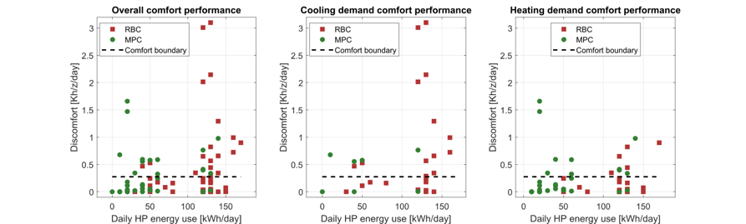

Implementation of MPC in Office Building in Belgium
The field test energy use performance of MPC (green) and RBC (red) during the transient season. Each dot represents one day.
The field test thermal comfort performance of MPC (green) and RBC (red) during the transient season. Each dot represents one day.
Highlights: Heat pump energy savings up to 53%.
Thermal comfort improvement up to 37%.
Drgona J., et al., Cloud-based implementation of white-box model predictive control for a GEOTABS office building: a field test demonstration. Journal of Process Control, 2020.
Notes:
To better understand the complexity of the task, lets walk through a complete workflow as implemented for a practical use case to control an office building in Belgium.
This office building is equipped with thermally activated building structures with a geothermal heat pump (GEOTABS). These kinds of buildings are known to be very challenging to control due to the large thermal mass and associated time delays. For optimal operation of this type of systems, predictive control is an absolute must.
First one develops a high-fidelity physics-based model based on the available engineering documentation and measurement data.
Then the control-relevant equations are extracted and used to construct an optimization-based predictive controller.
The optimized controls are computed every 15min based on new weather forecast and new measurement from the building, then the controls are communicated to the building management system for execution.
The whole procedure takes approximately a minute to execute in real time.
After using the MPC in the office building for a couple of months the team measured more than 50% energy savings on the heat pump and improved thermal comfort by approximately 37%. The rigid and delayed behavior of the rule-based controller is replaced by dynamic and anticipatory behavior of MPC, which keeps the zone temperatures closer within comfort bounds and delivers cooling only when it is needed.

Slide 7
Objective: Integrate Deep Learning with MPC and Physics
Automate learning of the system dynamics and model-based control policy
Streamline the installation process, facilitate explainability
Endow with lifelong learning and offer performance guarantees during the learning process

Slide 8
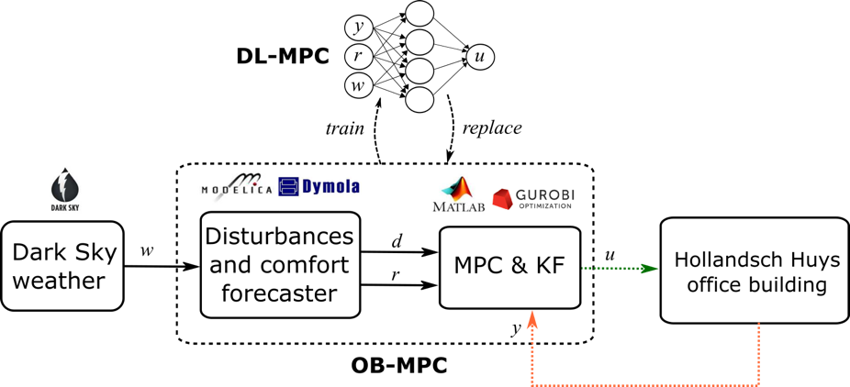
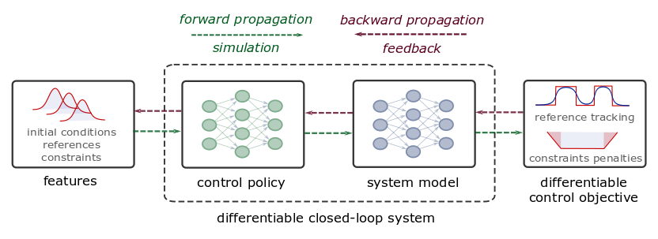
Deep Learning of MPC-based Control Policies
Approximate MPC
Supervised learning
Imitation learning of MPC
Requires original MPC and model
Guarantees are hard to obtain
Differentiable Predictive Control
Differentiable closed-loop model
Model-based policy optimization
Theoretical connection with MPC
Drgona J., et al., “Approximate model predictive building control via machine learning,” Applied Energy, 2018
Drgona J., Helsen L., Vrabie D., "Cutting the Deployment Costs of Physics-Based MPC in Buildings by Simulation-Based Imitation Learning.”, proceedings of Dynamic Systems and Control Conference 2020, - Best paper award
Drgona J., et al., Differentiable Predictive Control: An MPC Alternative for Unknown Nonlinear Systems using Constrained Deep Learning, 2021. https://arxiv.org/abs/2011.03699

Slide 9
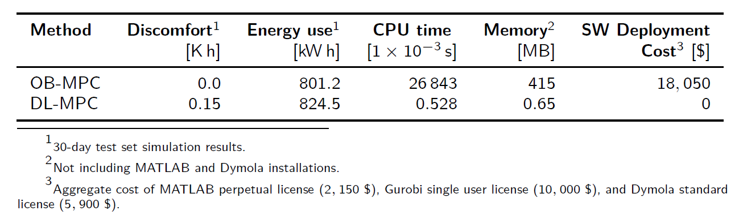
Deep Learning-based Approximations of MPC
Pros
Can accurately approximate MPC
Low CPU and memory demands
Cons
Loosing performance guarantees
Still relies on original MPC
Drgona J., et al., “Approximate model predictive building control via machine learning,” Applied Energy, 2018
Drgona J., Helsen L., Vrabie D., “Stripping off the implementation complexity of physics-based model predictive control for buildings via deep learning.” NeurIPS Climate Change AI workshop, 2019.
Drgona J., Helsen L., Vrabie D., "Cutting the Deployment Costs of Physics-Based MPC in Buildings by Simulation-Based Imitation Learning.”, proceedings of Dynamic Systems and Control Conference 2020, - Best paper award

Slide 10

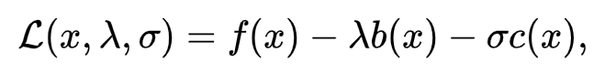
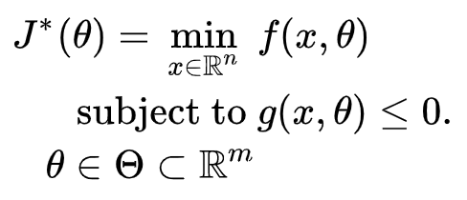

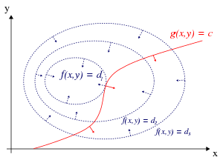
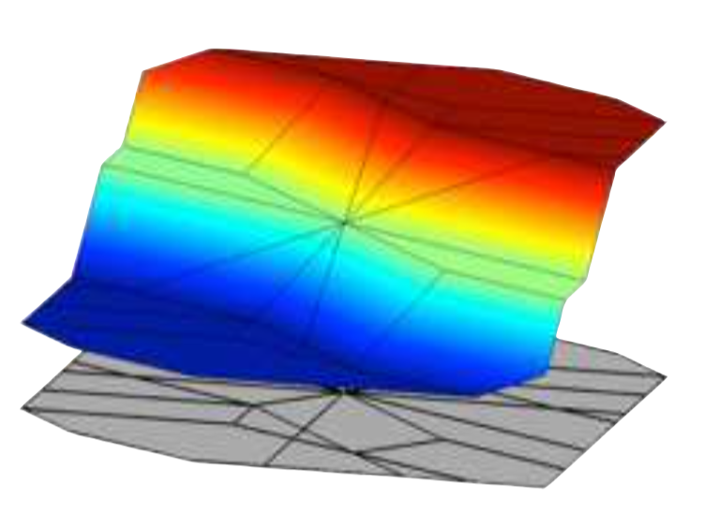


Formulations of Constrained Optimization Problems
Standard form
Lagrangian form
Parametric programming
Machine learning
“online” optimization
Single solution for
given parameter values
“online” optimization
Using soft constraints
Instead of hard constraints
“offline” optimization
Obtains a solution map
for a set of parameters
“offline” optimization
Obtains a model (map)
for a set of datapoints
Notes:
There are four main challenges that must be overcome to make MPC cost-effective
The Training and calibration of models – must be automated
The translation of the optimization problems to a solver language – must be automated
To address the computational limitations of embedded hardware - must reduce computing need without trading performance
Acceptance by building operators – complex decisions must be translated to interpretable decision rules

Slide 11
Formulations of Constrained Optimization Problems
Standard form
Lagrangian form
Parametric programming
Machine learning
“online” optimization
Single solution for
given parameter values
“online” optimization
Using soft constraints
Instead of hard constraints
“offline” optimization
Obtains a solution map
for a set of parameters
“offline” optimization
Obtains a model (map)
for a set of datapoints
Data-driven differentiable parametric optimization (D3PO): Combining principles of
Lagrangian formulation, parametric programming and ML
Notes:
There are four main challenges that must be overcome to make MPC cost-effective
The Training and calibration of models – must be automated
The translation of the optimization problems to a solver language – must be automated
To address the computational limitations of embedded hardware - must reduce computing need without trading performance
Acceptance by building operators – complex decisions must be translated to interpretable decision rules

Slide 12
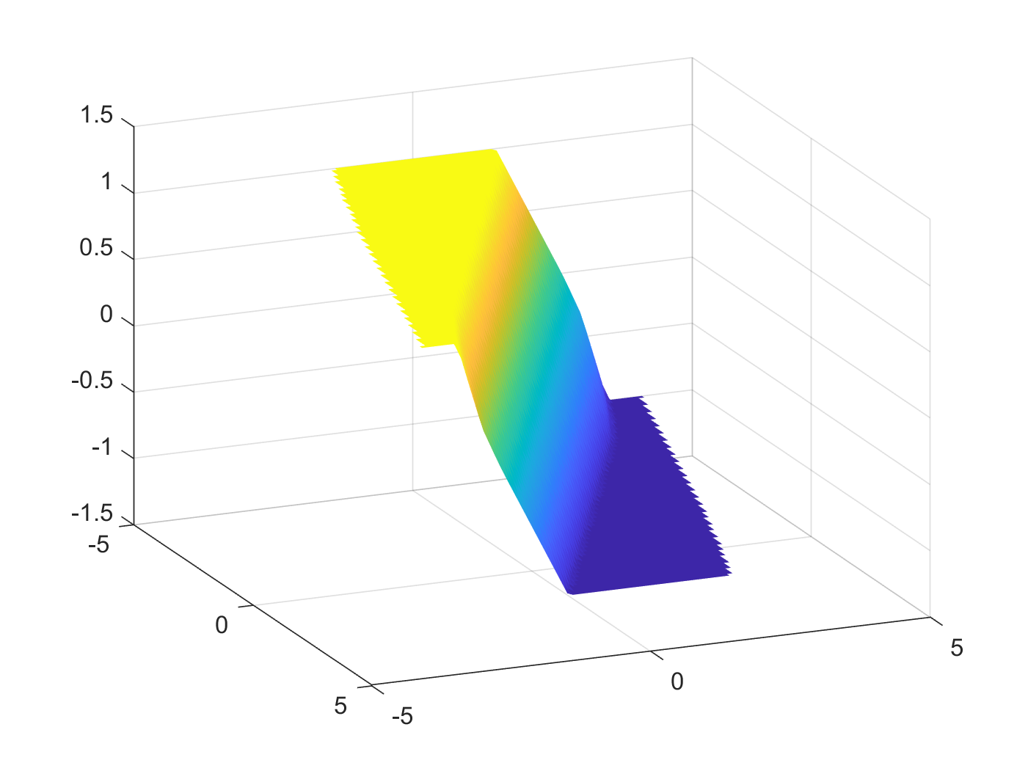

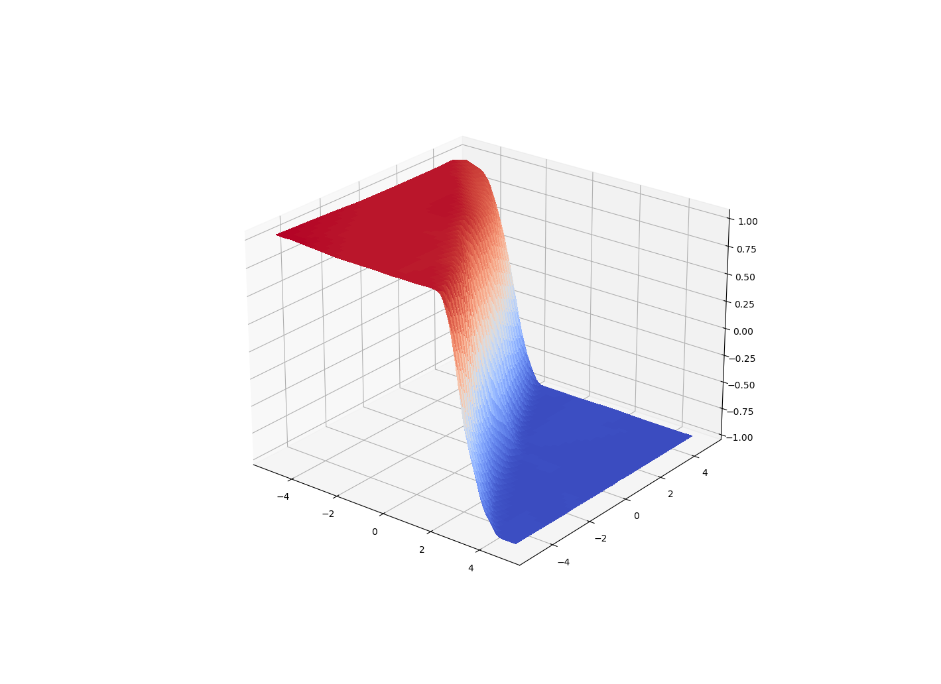
Data-Driven Differentiable Parametric Optimization (D3PO)
D3PO problem definition:
Applications:
Optimization
Modeling
Control
with constraints
Solution of parametric quadratic
program with classical solver.
Optimize x, given dataset
by finding a mapping x=h( )
D3PO implementation using Neuromancer:
import neuromancer as nm dataset = nm.datasets.Dataset(sequences=data)
components = nm.policies.SolutionMap(**kwargs) objectives = nm.Objective(torch.norm(z, 2)), weight=Q_x) constraints = nm.Objective(torch.norm(F.relu(torch.mm(A, z.T)-b), 1), weight=Q_con) problem = nm.Problem(objectives, constraints, components)
optimizer = torch.optim.AdamW(model.parameters(), lr)
trainer = nm.Trainer(problem, dataset, optimizer, epochs) best_model = trainer.train()
D3PO solution of
parametric quadratic program.
https://github.com/pnnl/neuromancer
https://github.com/pnnl/slim

Slide 13
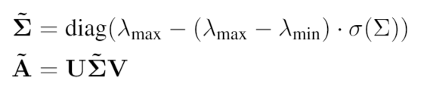
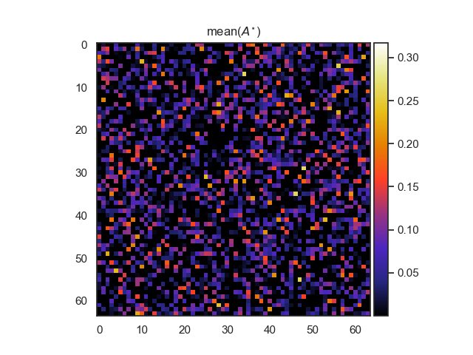
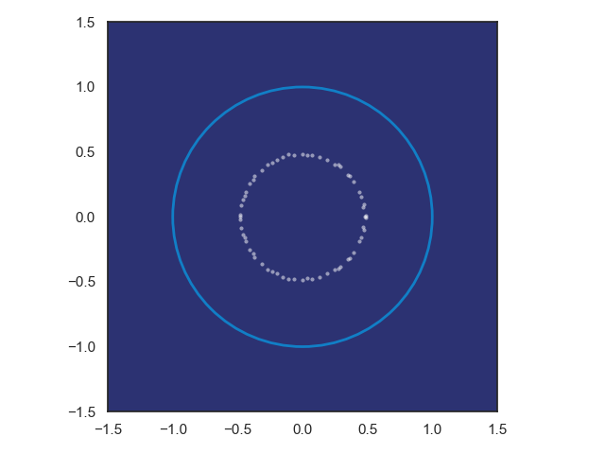
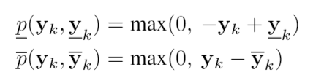
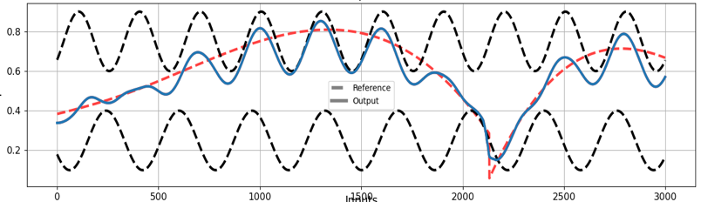
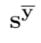
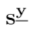
Constrained Neural Models in D3PO
Structured linear algebra:
Eigenvalues, sparsity, rank, positive definiteness
Loss function terms:
Regularizations
Penalty methods
Physics-informed neural networks
Neural models for dynamical systems:
Neural state space models
Energy-based models
Constrained optimal control
Differentiable predictive control

Slide 14
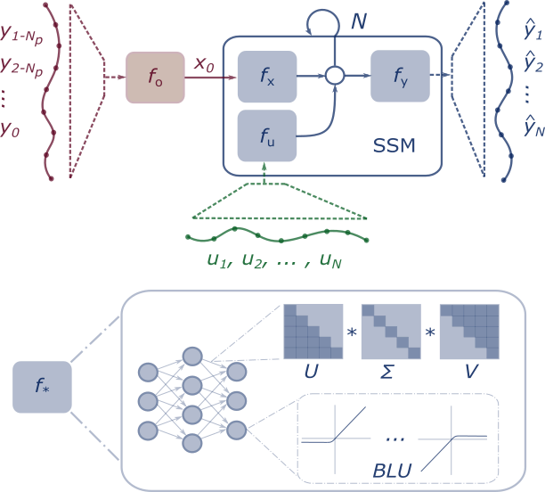
Differentiable Predictive Control (DPC)
Stage I: System Identification
Stage II: Policy Optimization
Fixed SSM Parameters
System ID
Loss
Reference
Tracking
Loss
Dataset of perturbed system measurements
Synthetic random dataset of references and system states
Notes:
Integrate Deep Learning with Optimization-Based Control
Machine learning models that respect physical laws
Incorporate domain knowledge in their architectures
Incorporate domain knowledge with auxiliary loss functions
Use cases
Optimal control
Predictive maintenance
Surrogates for inverse problems
Forecasting for high level planning
Configurable optimization
Sequential
Joint
Alternating
Online updates
Scalable inference
Fast sampling rates
Limited computational resources
High dimensional state space
Long prediction horizons

Slide 15
Constrained Neural State Space Models
Machine learning models that respect physical laws and constraints
Structured architectures
Physics-informed loss functions
Constraints enforcing penalties
Learnable activation functions
Structured linear maps
Elliott Skomski, et al., Constrained Block Nonlinear Neural Dynamical Models, American Control Conference (ACC) 2021.
A. R. Tuor, J. Drgona, D. L. Vrabie, Constrained Neural Ordinary Differential Equations with Stability Guarantees, ICML workshop 2020.

Slide 16
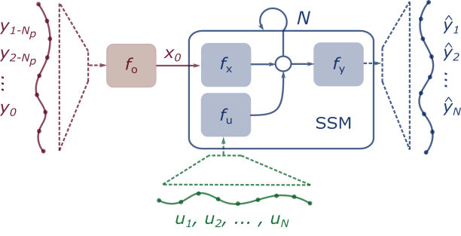
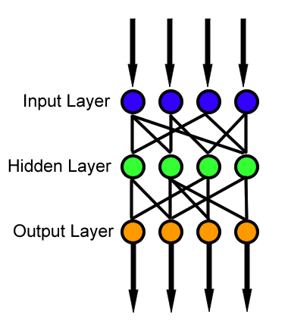
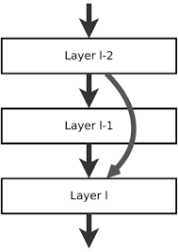
Neural Network Block Structure and Components
Multi-layer perceptron
Function approximator
Composed linear maps and nonlinear activation functions
Model complicated functions
adding depth (more layers)
and/or width (more nodes)
Residual Neural Network
Adds shortcut connections
Easier to optimize
Mitigates vanishing gradient
Recurrent Neural Network
Adds recurrences from previous inputs
Sequential modeling
Can model time delay
f

Slide 17
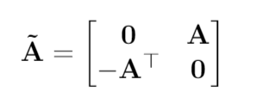
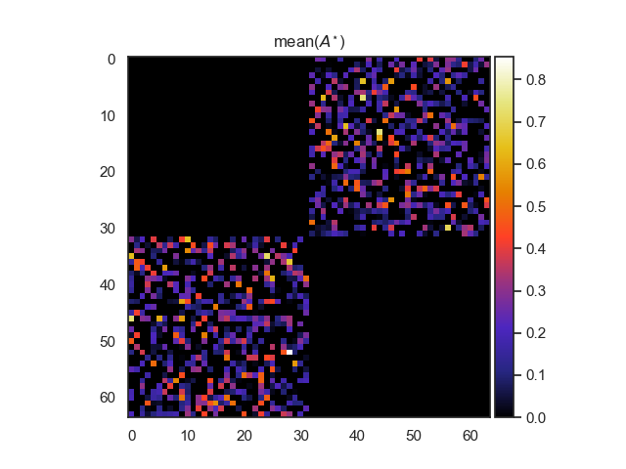
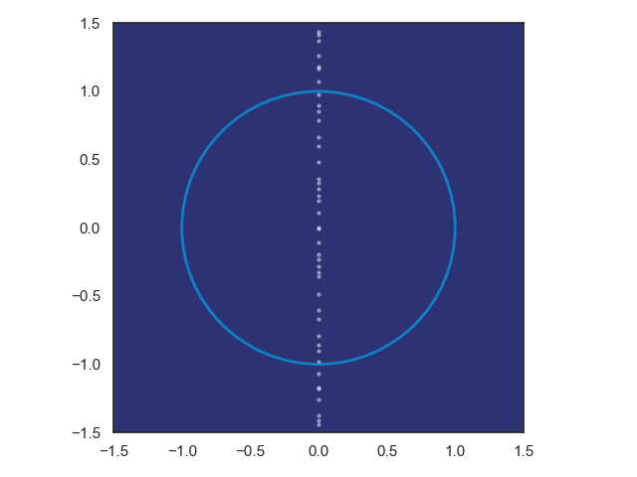
Structured Linear Maps with Eigenvalue Constraints
SVD factorization
Hamiltonian weight
Jiong Zhang, et al., Stabilizing Gradients for Deep Neural Networks via Efficient SVD Parameterization, 2018. Eldad Haber and Lars Ruthotto, Stable Architectures for Deep Neural Networks 2017 Jan Drgona, Aaron Tuor, Soumya Vasisht, Elliott Skomski, Draguna Vrabie, Spectral Analysis and Stability of Deep Neural Dynamics, arXiv:2011.13492 Code: https://github.com/pnnl/slim

Slide 18
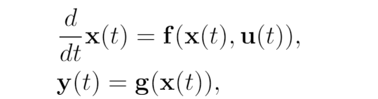
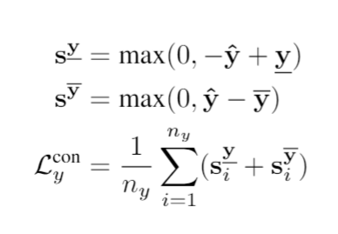
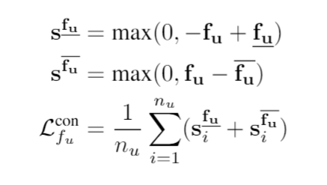
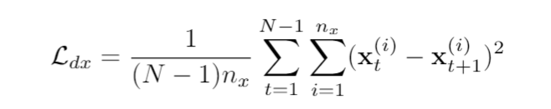
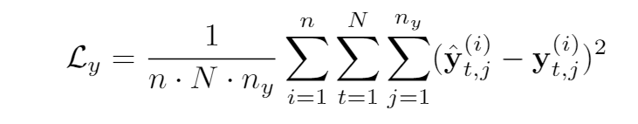
Training Constrained Neural State Space Models
Partially observable non-autonomous system
Bound influence of input and bound output to physical range
Dataset:
Predicted State Smoothing
Multi-term loss function:
Optimize N-step prediction horizon MSE
Elliott Skomski, Ján Drgoňa, Aaron Tuor, Automating Discovery of Physics-Informed Neural State Space Models via Learning and Evolution, Proceedings of the 3rd Conference on Learning for Dynamics and Control (L4DC), 2021.

Slide 19
Modeling Thermal Dynamics
Ján Drgona, et al., Physics-constrained deep learning of multi-zone building thermal dynamics, Energy and Buildings, 2021

Slide 20
Real World Data: Office Building

Slide 21
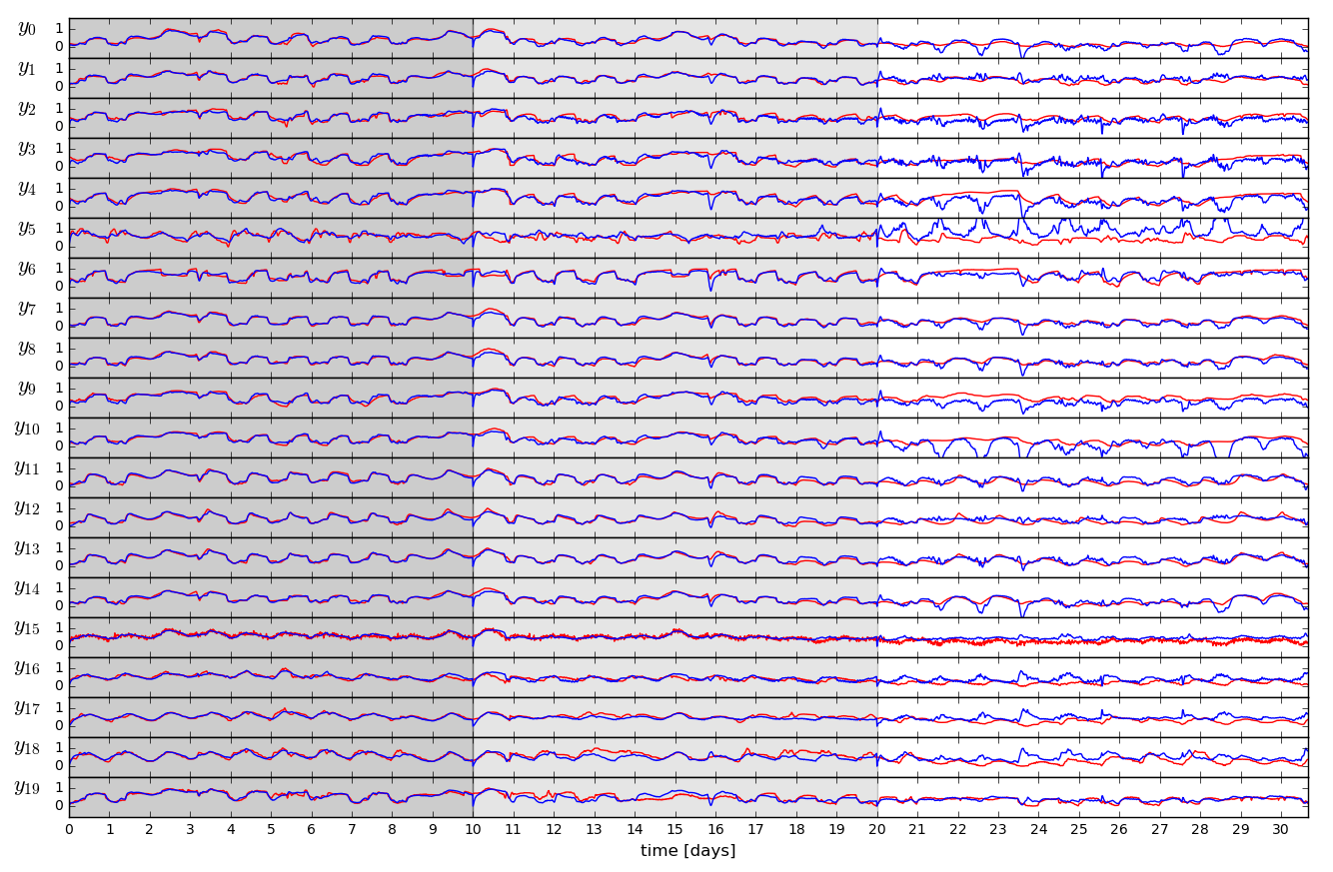
Open-loop Trajectories of Linear Dynamics Model
Ján Drgona, et. al, Physics-constrained deep learning of multi-zone building thermal dynamics, Energy and Buildings, 2021

Slide 22
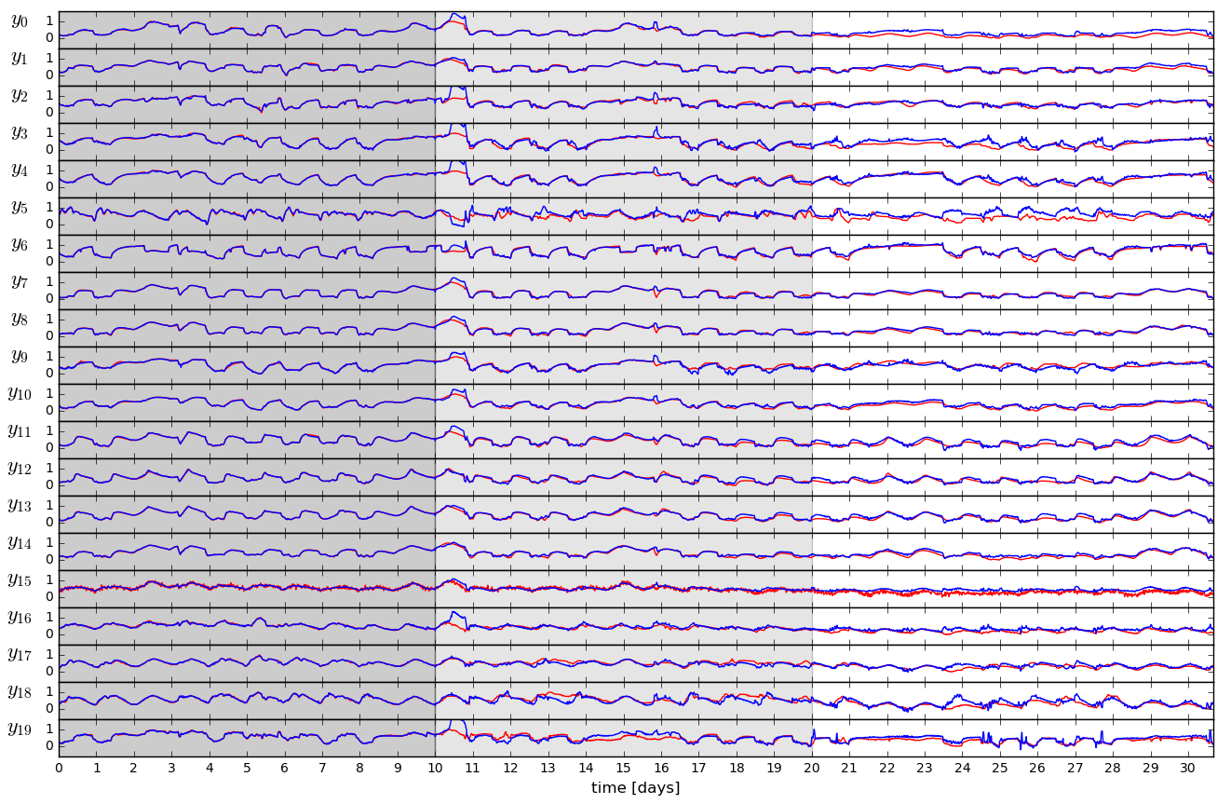
Open-loop Trajectories of Neural Dynamics Model
Ján Drgona, et. al, Physics-constrained deep learning of multi-zone building thermal dynamics, Energy and Buildings, 2021

Slide 23
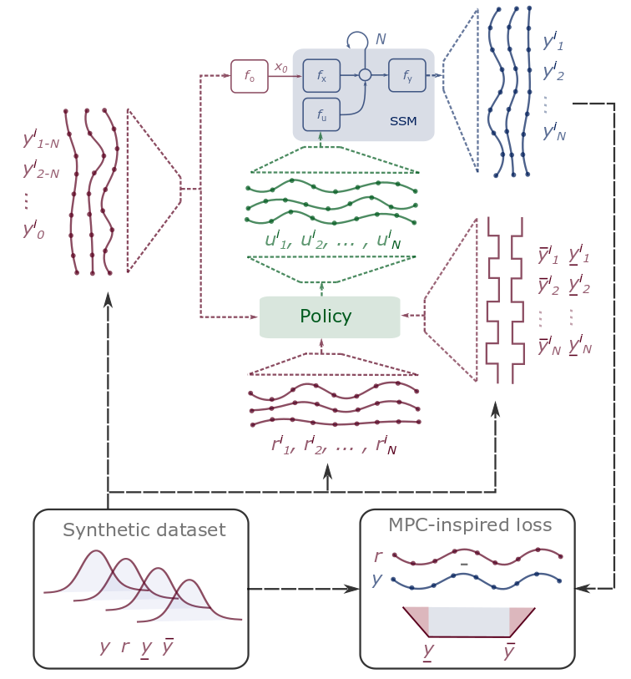
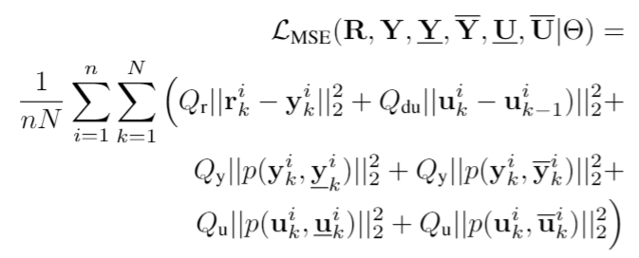
Differentiable Predictive Control (DPC)
Generic method for constrained model-based control
Can be trained end-to-end from time series dataset
Explicit neural network-based control policy
Scalability beyond the limitations of explicit MPC
Jan Drgona, et al., Differentiable Predictive Control: An MPC Alternative for Unknown Nonlinear Systems using Constrained Deep Learning https://arxiv.org/abs/2011.03699
Jan Drgona, Aaron Tuor, Draguna Vrabie, Constrained Physics-Informed Deep Learning for Stable System Identification and Control of Unknown Linear Systems https://arxiv.org/abs/2004.11184

Slide 24
Model Predictive Control vs Differentiable Predictive Control
DPC = Formulation of MPC problem as a constrained deep learning model
Jan Drgona, Aaron Tuor, Draguna Vrabie, Constrained Physics-Informed Deep Learning for Stable System Identification and Control of Unknown Linear Systems https://arxiv.org/abs/2004.11184

Slide 25
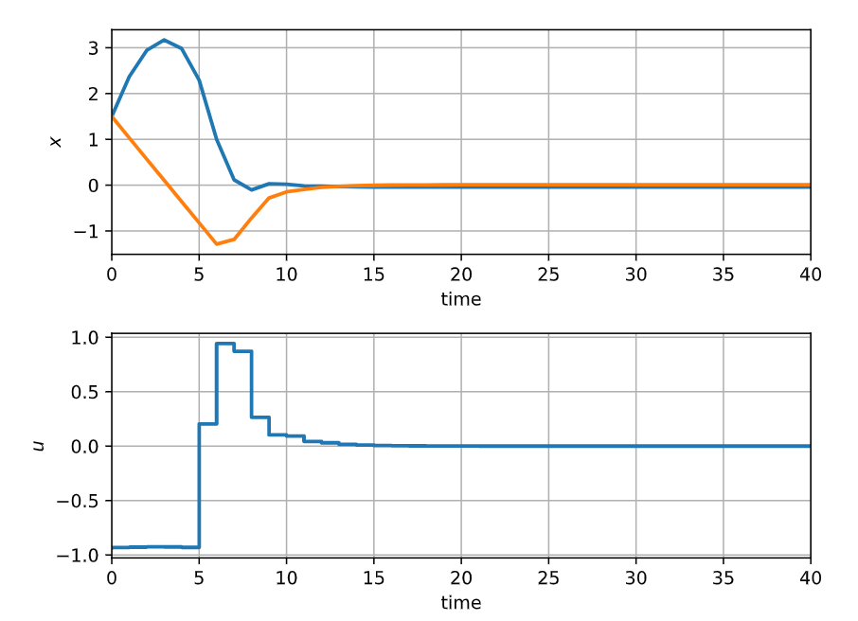
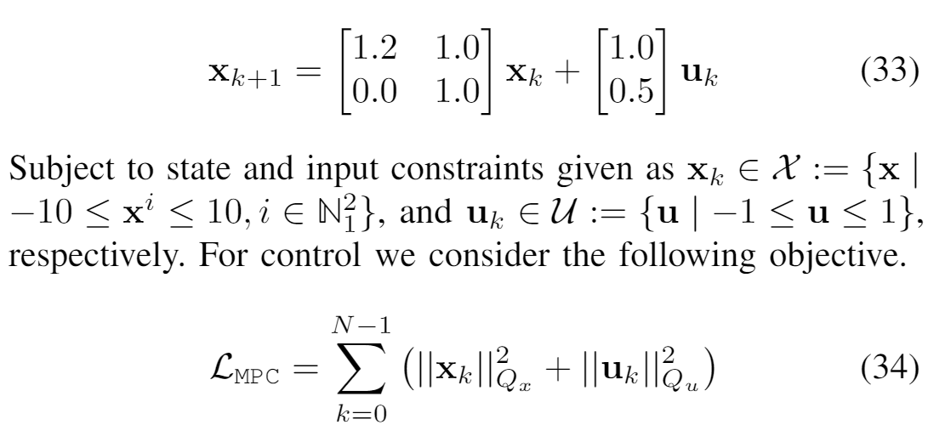
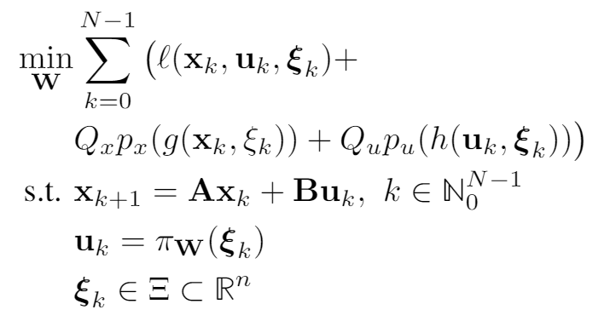
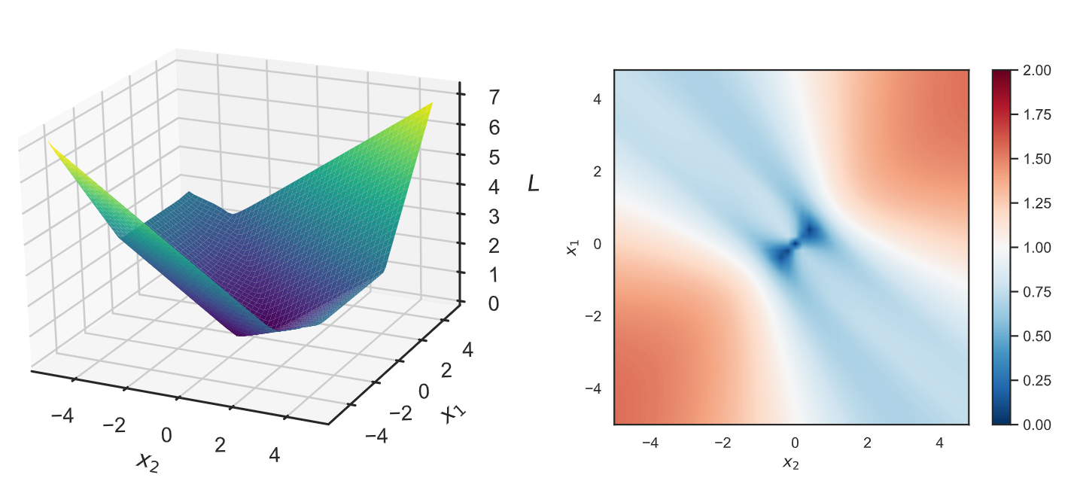
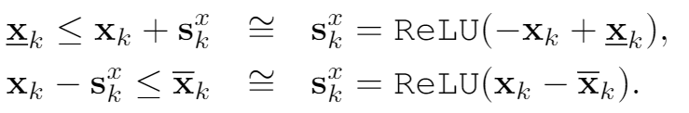
Safety: Learning to Stabilize Unstable System with DPC
Problem setup:
DPC formulation:

Slide 26
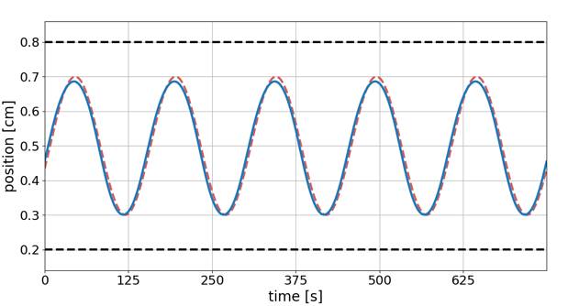
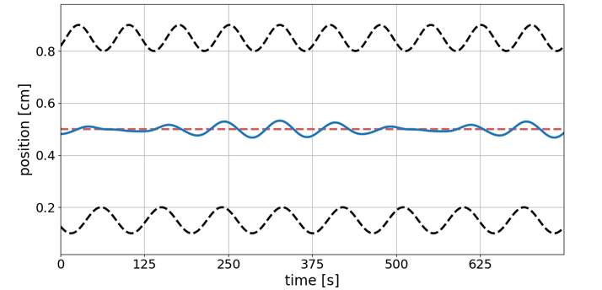
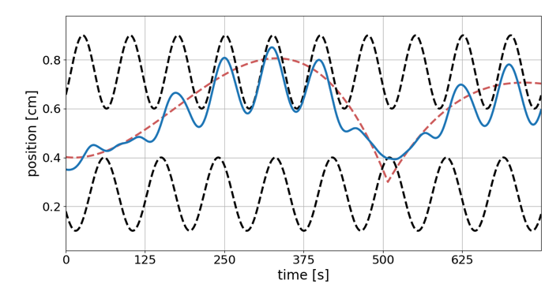
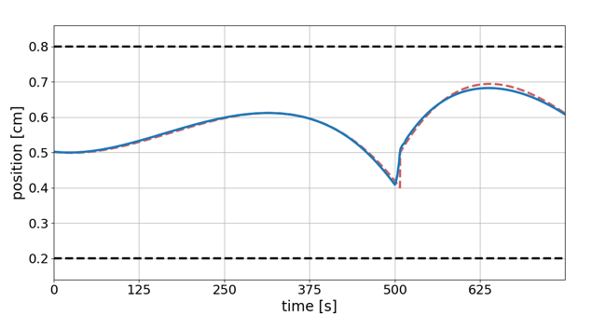
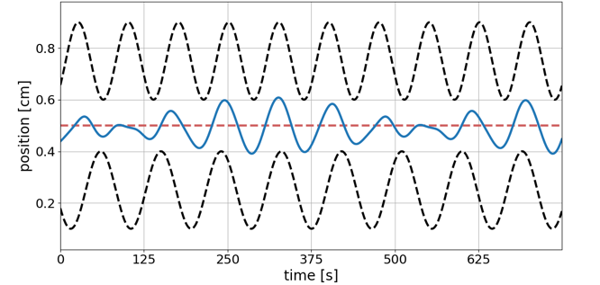
Performance: Computationally efficient optimization with operational constraints
--- Reference trajectory
--- Constraints
__ Controlled trajectory
Reference tracking performance
Response to constraint tightening
Balancing conflicting objectives
Notes:
Computationally efficient performance optimization with operational safety constraints

Slide 27
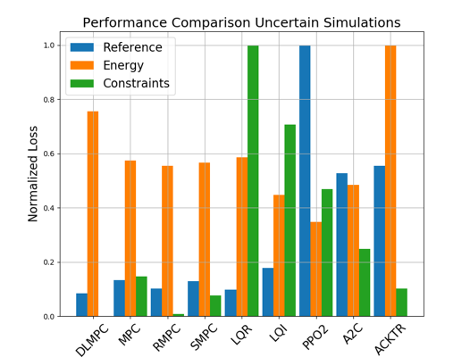
Comparison of DPC with MPC, LQR, and RL
Closed loop trajectories. Top: controlled state (orange), internal model predictions (green), given reference (dashed blue), and constraints (dashed black). Middle: control action (blue) and bounds (dashed black). Bottom: disturbances
Control performance comparison in simulations with parametric and additive uncertainties. Control Strategies: MPC, Robust MPC , Stochastic MPC, LQR, LQI, A2C: Asynchronous, deterministic variant of Advantage Actor Critic, ACKTR: Actor Critic using Kronecker-Factored Trust Region, PPO2: Proximal Policy Optimization
Drgona J., Tuor A., Vrabie D., Constrained Physics-Informed Deep Learning for Stable System Identification and Control of Linear Systems, Code release: https://github.com/pnnl/deps_arXiv2020

Slide 28




Economic DPC for Building Control
Economic MPC loss function
model
policy
Jan Drgona, Aaron Tuor, Elliott Skomski, Soumya Vasisht, Draguna Vrabie, Deep Learning Explicit Differentiable Predictive Control Laws for Buildings, accepted for IFAC NMPC 2021

Slide 29

Closed-loop Performance of DPC on Learned Model without Plant-Model Mismatch
Jan Drgona, Aaron Tuor, Elliott Skomski, Soumya Vasisht, Draguna Vrabie, Deep Learning Explicit Differentiable Predictive Control Laws for Buildings, accepted for IFAC NMPC 2021

Slide 30

Closed-loop Performance of DPC on Emulator Model with Plant-Model Mismatch
Jan Drgona, Aaron Tuor, Elliott Skomski, Soumya Vasisht, Draguna Vrabie, Deep Learning Explicit Differentiable Predictive Control Laws for Buildings, accepted for IFAC NMPC 2021

Slide 31
Embedded Implementation of DPC
Flexy-Air system sketch with Raspberry-Pi controller
Performance comparison: reference (red dashed), position controlled with PI controller (green), explicit model predictive control (purple), constrained differentiable predictive control (blue) and constraints (black-dashed). Bottom figures show the fan speed controls
Jan Drgona, Karol Kis, Aaron Tuor, Draguna Vrabie, Martin Klauco, Differentiable Predictive Control: An MPC Alternative for Unknown Nonlinear Systems using Constrained Deep Learning; arXiv:2011.03699

Slide 32









Conclusion
Differentiable Predictive Control
Neural state space model for system ID
Incorporating constraints (neural gray-box)
Theoretical connection with MPC
Explicit neural control policies
Embedded implementation with low-cost HW
Ongoing work
Uncertainty Quantification
Plant-model mismatch
Theoretical guarantees: convergence, stability, constraints satisfaction
Code development
Neuromancer software package
https://github.com/pnnl/neuromancer
Structured linear maps in Pytorch
https://pnnl.github.io/slim/
Long-Term Vision
Causal discovery, dynamical coupling
Solving large-scale non-convex constrained optimization problems
Applications in energy, manufacturing, cyber

Slide 33
Backup: Dynamical Analysis of Deep Neural Networks
Motivation
Safety-critical and high-performance systems call for formal verification methods to ensure safe operation.
Lack of guarantees on global and local behavior of DNNs still remain limiting factors.
Properties like stability and robustness are crucial for reliable system identification and control.
Goal
Apply system- and control-theoretic analysis methods on DNNs.
Provide stability guarantees, identify regions of attraction and achieve desired dynamical behavior with DNNs.
Jan Drgona, Aaron Tuor, Soumya Vasisht, Elliott Skomski, Draguna Vrabie, Spectral Analysis and Stability of Deep Neural Dynamics, arXiv:2011.13492

Slide 34








Spectral Analysis and Stability of Deep Neural Networks
Jacobians of DNNs as pointwise parameter-varying affine maps.
At every point , the neural network, may be represented as
where represent the weight parameterizations at layer , and is a diagonal matrix that represents the element-wise application of the nonlinear activation function at layer .
Jan Drgona, Aaron Tuor, Soumya Vasisht, Elliott Skomski, Draguna Vrabie, Spectral Analysis and Stability of Deep Neural Dynamics, arXiv:2011.13492
Notes:
The presentation I’m giving today is for a data-driven method for dynamics modeling.
We should care about this because people interact with and depend on complicated systems all the time.
Greater understanding of these systems can lead to outcomes which are
More energy efficient
Cost effective
Conducive to human life
Having an accurate model of a system enables scientific discovery,
Can provide critical information to support high stakes decisions in changing environments
Or to provide necessary information for predictive maintenance of high value equipment, avoiding costly and potentially dangerous equipment
Failures.
One of the most common and lucrative uses of systems models are for predictive control in manufacturing and other large scale enterprises.
I’m presenting a method today which bridges benefits of traditional physics-based modeling with more recent data-driven modeling using deep learning
Traditional physics-based modeling works very well and is widely used in many real world applications. However, it can’t always be applied to every situation.
missing information
incomplete awareness of the model state space.
limitations on the available operational data.
For large scale systems, not only are they difficult to model from first principles, it is also not always possible to simulate the system in real time.
Data-driven approaches for systems modeling are an alternative in these situations but can come with their own disadvantages.
Can take a lot of data to train and may behave unpredictably outside the distribution of training data in unobserved regions of the system state space.
In addition, modern neural network approaches don’t typically provide constraints enforcement within physically realizable and operationally safe bounds,

Slide 35

Dynamical Effects of Weights
Jan Drgona, Aaron Tuor, Soumya Vasisht, Elliott Skomski, Draguna Vrabie, Spectral Analysis and Stability of Deep Neural Dynamics, arXiv:2011.13492

Slide 36


Dynamical Effects of Activation Functions
Jan Drgona, Aaron Tuor, Soumya Vasisht, Elliott Skomski, Draguna Vrabie, Spectral Analysis and Stability of Deep Neural Dynamics, arXiv:2011.13492

Slide 37

Dynamical Effects of Network Depth
Exponentially stable layers
imply vanishing gradient problem
Network with energy conversion prevents gradient problems
Unstable layers imply exploding gradient problem
Jan Drgona, Aaron Tuor, Soumya Vasisht, Elliott Skomski, Draguna Vrabie, Spectral Analysis and Stability of Deep Neural Dynamics, arXiv:2011.13492

Slide 38


Attractors of Deep Neural Networks
Jan Drgona, Aaron Tuor, Soumya Vasisht, Elliott Skomski, Draguna Vrabie, Spectral Analysis and Stability of Deep Neural Dynamics, arXiv:2011.13492

Slide 39
Attractors of Deep Neural Networks
Jan Drgona, Aaron Tuor, Soumya Vasisht, Elliott Skomski, Draguna Vrabie, Spectral Analysis and Stability of Deep Neural Dynamics, arXiv:2011.13492

